Slide 1
Small Regulatory RNA I
Mary (Junyan) Li
Millar Lab
junyan.li@anu.edu.au

Slide 2
Central dogma of molecular biology (v1.0)
DNA
Transcription
Infrastructural:
tRNA, rRNA
RNA
Translation
Structural
Protein
Regulatory
Catalytic

Slide 3
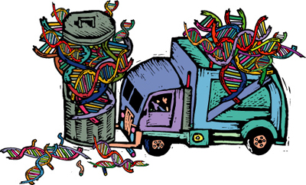
Junk DNA?
Over 98% of the human genome is noncoding DNA.
Of those 98%, about 50-70% are introns.
The rest is transcribed into rRNA, tRNA and a vast number of other non-coding RNAs (ncRNAs).
“When a given DNA, or class of DNAs, of unproven phenotypic function can be shown to have evolved a strategy (such as transposition) which ensures its genomic survival, then no other explanation for its existence is necessary." –Doolittle and Sapienza, 1980. Nature 284, 601 – 603.

Slide 4
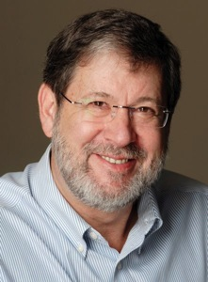
John Mattick
~2000:
Junk DNA is not junk:
ncRNAs have
important regulatory roles.

Slide 5
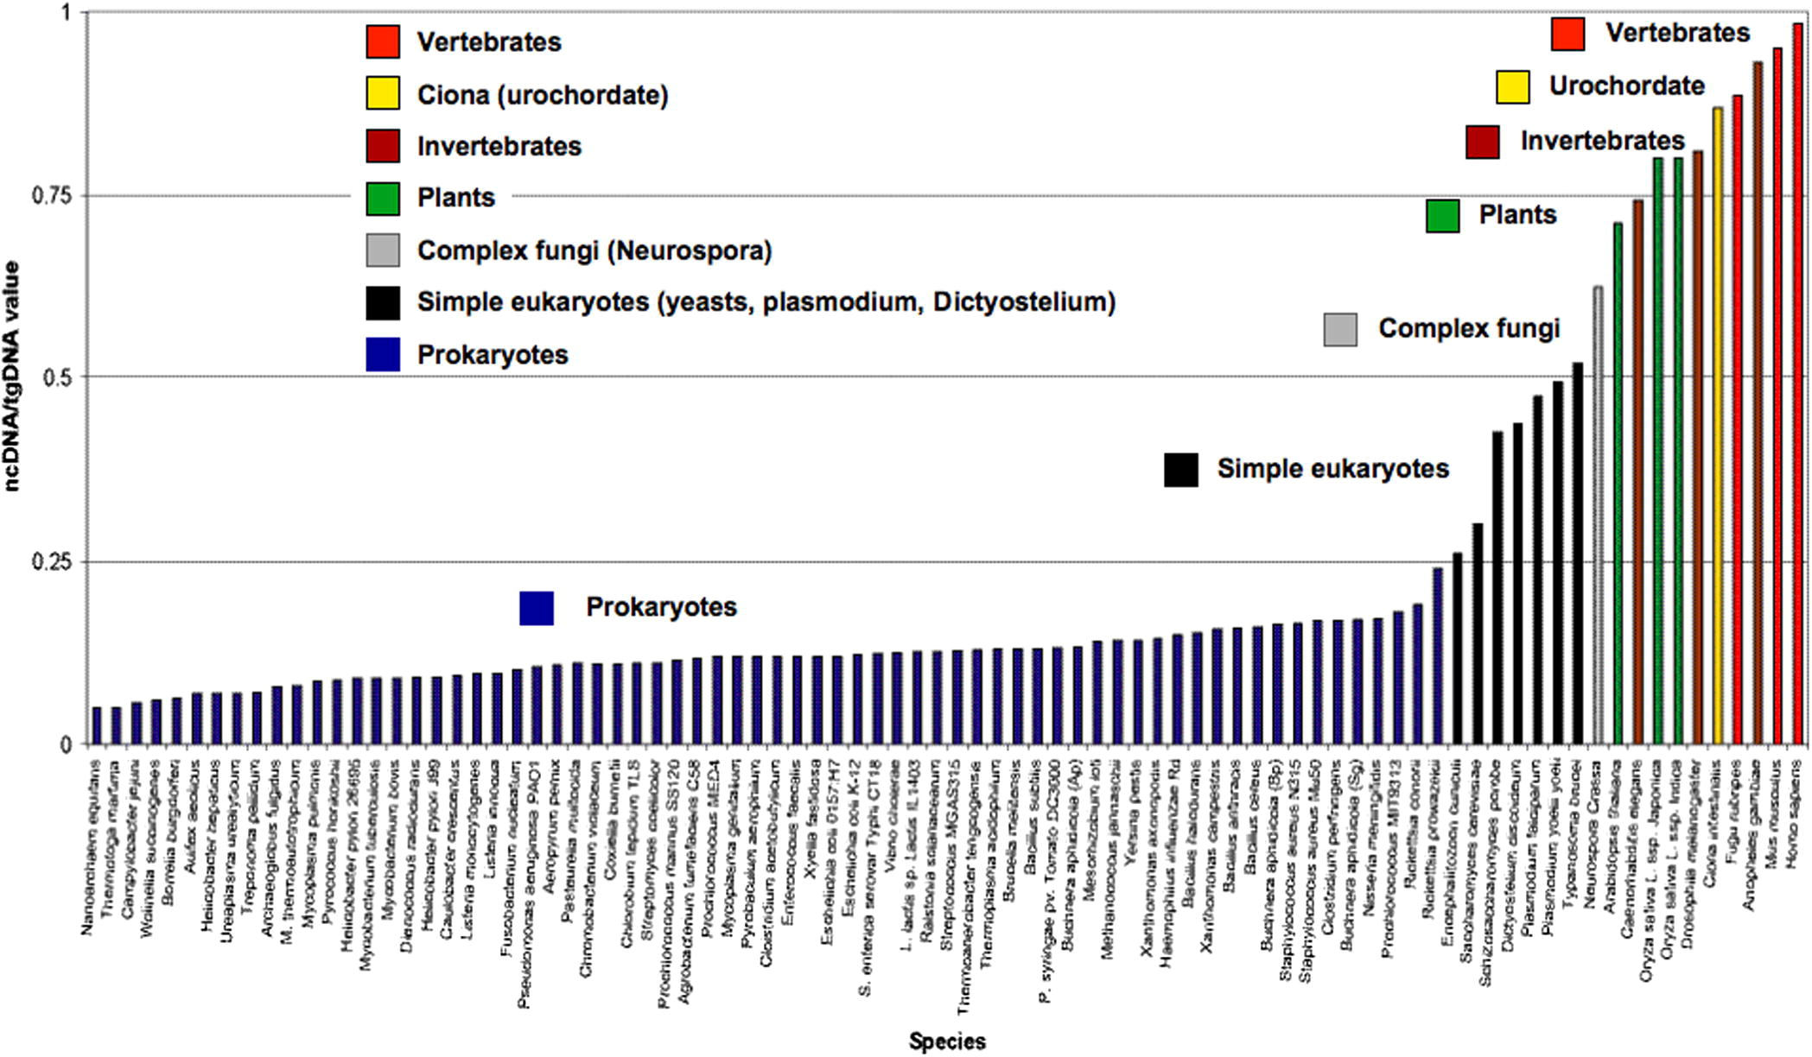
Organismic complexity scales with ncDNA content
Blba
Bla
Mattick, J. S. (2011). FEBS letters, 585(11), 1600–1616.

Slide 6
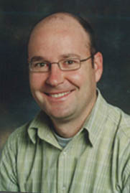
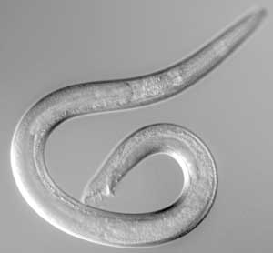
Number of protein coding genes is not correlated with organismic complexity
Human
≈ 25,000 protein coding genes.
100,000,000,000,000 cells.
E.g. 44 facial muscles
≈5000 facial expressions
Worm
≈ 25,000 protein coding genes.
1000 cells.
Does non-coding RNA underlie this complexity?

Slide 7
A refined central dogma of molecular biology (v2.0)
1. Chromatin structure
DNA
2. Transcription
Transcription
Infrastructural:
tRNA, rRNA etc
Regulatory
non-coding RNAs
RNA
Translation
3. RNA stability
4. RNA processing
5. Translation
Structural
Protein
Regulatory
Catalytic

Slide 8
Lecture Outline
Part I: An overview
RNA interference and pathway components;
Short interfering RNAs (siRNAs): Biogenesis and functions
Application;
Part II: MicroRNAs
Biogenesis and functions;
Target identification;
Functional study;

Slide 9
Let’s have a taste of small RNAs.

Slide 10
Discovery of RNA interference:
The experiment led to a Noble Prize

Slide 11
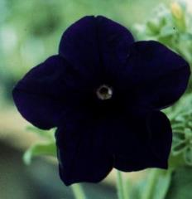

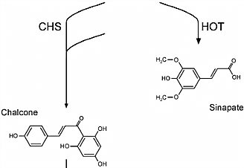
Manipulation of chalcone synthase expression to modify pigmentation
Chalcone synthase (CHS)
Wild-type petunia producing purple anthocyanin pigments
Chalcone synthase (CHS) is the enzyme at the start of the biosynthetic pathway for anthocyanins
Anthocyanins
Photo credit Richard Jorgensen; Aksamit-Stachurska et al. (2008) BMC Biotechnology 8: 25.

Slide 12
Manipulation of CHS in petunia
Endogenous gene
Protein translated
mRNA
PRO
ORF
mRNA
Transgene
Sense-antisense duplex forms and prohibits translation
Antisense construct:
Antisense RNA
PRO
ORF
Transgene
Extra protein translated
Sense construct:
Sense RNA
mRNA
PRO
ORF
mRNA
Napoli, C., Lemieux, C., and Jorgensen, R. (1990) Plant Cell 2: 279–289.

Slide 13
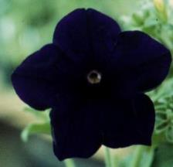
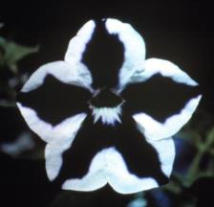
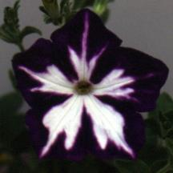
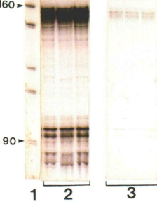
The sense gene construct also inhibits endogenous CHS expression – Co-suppression
Photo credit Richard Jorgensen
Plants carrying CHS transgene
Transgene RNA
CaMV 35S pro : CHS
CaMV 35S pro :
CHS
Endogenous gene RNA
Napoli, C., Lemieux, C., and Jorgensen, R. (1990) Plant Cell 2: 279–289.
Notes:
Cosuppression in Drosophila: gene silencing of Alcohol dehydrogenase by white-Adh transgenes is Polycomb dependent
Sense cosuppression was the first form of eukaryotic post-transcriptional gene silencing reported (Jorgensen 1995).
Sense cosuppression was the first form of eukaryotic post-transcriptional gene silencing reported (Jorgensen 1995). It arises when transgenes designed to overexpress a host protein instead cause suppression of homologous host transcripts by inducing mRNA degradation. This phenomenon was originally described in transgenic petunia in which expression of the chalcone synthase-A(CHS-A) gene, required for the biosynthesis of anthocyanin pigments in the flower, was inhibited by the overexpression of a homologous sense transgene (Napoli et al. 1990). Later, CHS-A expression loss was associated with mRNA degradation by endonucleolytic cleavage (Metzlaff et al. 1997), which identified cosuppression as an RNA silencing mechanism (Baulcombe 2004). Nevertheless, as for most forms of gene silencing in transgenic organisms, the production of small interfering RNAs (siRNAs), assumed to be determinants of CHS-A silencing, has yet to be characterized. Here we provide evidence from deep sequencing of a causative relationship between the process of CHS-A sense cosuppression and the elevation of two specific siRNAs that vastly predominate and guide prominent mRNA cleavage events.
In biology, and specifically genetics, epigenetics is the study of heritable changes in gene activity that are not caused by changes in the DNA sequence; it also can be used to describe the study of stable, long-term alterations in the transcriptional potential of a cell that are not necessarily heritable. Unlike simple genetics based on changes to the DNA sequence (the genotype), the changes in gene expression or cellular phenotype of epigenetics have other causes, thus use of the term epi- (Greek: επί- over, outside of, around) -genetics.^{[1]}

Slide 14
Double stranded RNA triggers RNA silencing:
RNA Interference (RNAi)
Worms have a muscle gene unc-22 that controls worm movement; without it worms will be crippled (twitching).
Sense RNA
Antisense RNA
Double-stranded RNA
Inject into worms
Worm:
Normal
Normal
Twitching
unc-22
mRNA:
Present
Present
None
Fire et al., (1998) Nature 391, 806-811
Nobel Prize in Physiology or Medicine 2006- Mello and Fire
Notes:
In 1998, Fire and Mello published a seminal paper that
provided an explanation for the previously reported
silencing of endogenous genes by “cosuppression,
quelling and sense mRNA” (4). Working withC. elegans,
they tested the hypothesis that the trigger for gene
silencing was not single-stranded RNA (ssRNA) but
double-stranded RNA (dsRNA).

Slide 15
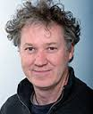
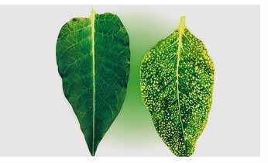
Double stranded RNA triggers gene silencing
dsRNA leads to viral resistance and gene silencing in plants
Sense RNA
antisense RNA
Double-stranded RNA
Challenge
tobacco leaves with virus
Immunity:
Susceptible
Susceptible
Resistant
Viral RNA:
Present
Present
None
CSIRO Plant Industry –Waterhouse et al., (1998) PNAS 95;13959

Slide 16
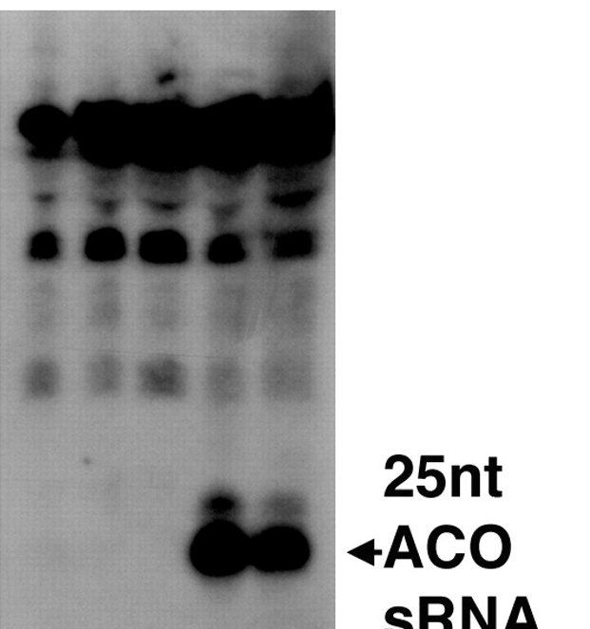
Small RNAs (sRNAs) are gene silencing intermediate
sRNAs are degradation products that give specificity to gene silencing.
Small interfering RNA (siRNA)
Small RNA
Approx. 21 nts
Hamilton and Baulcombe (1999) Science, 286:950

Slide 17
Small RNA pathway:
Biogenesis and functions

Slide 18
RNA interference: Pathway for gene silencing
hpRNA, dsRNA precursor
Dicer (DCL)
AGONAUTE (AGO):
Catalytic machinery
ssRNA: Specificity
Cleavage
AGO
dsRNA: 19-24 nt
AGO
RNA Induced
Silencing Complex (RISC)
AAAn
hp- hairpin
ds- double stranded
ss- single stranded
AGO
AAAn
Translational repression
mRNA degradation
Transcriptional silencing
Notes:
Transposable elements (retroelements), convergent RNA transcripts, natural sense-antisense gene pairs, hairpin RNAs, transgenes, (anti-sense + sense transcripts)
Triggered by exogenous and endogenous genetic information, that are in forms of hpRNA, dsRNA; or can be transcribed into those two forms. The consequent precursors are then recognized and cut by

Slide 19
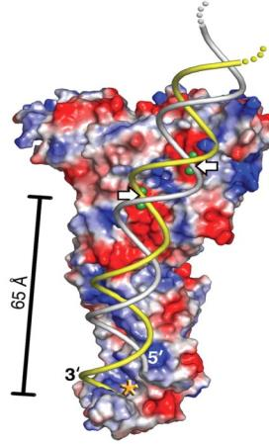
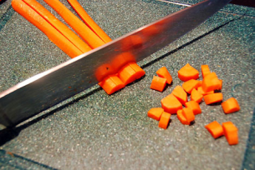
Dicer : A portal into RNA silencing
RNase III, A molecular ruler
From MacRae, I.J., Zhou, K., Li, F., Repic, A., Brooks, A.N., Cande, W.., Adams, P.D., and Doudna, J.A. (2006) Structural basis for double-stranded RNA processing by Dicer. Science 311: 195 -198. Reprinted with permission from AAAS. Photo credit: Heidi
Notes:
Note the two strands of the RNA molecule. The cleavage sites are indicated by yellow arrows.
Dicer’s structure allows it to measure the RNA it is cleaving. Like a cook who “dices” a carrot, Dicer chops RNA into uniformly-sized pieces.
Dicer is an endoribonuclease in the RNase III family that cleaves double-stranded RNA (dsRNA) and pre-microRNA (miRNA) into short double-stranded RNA fragments about 20-25 base pairs long, with a two-base overhang on the 3' end. Dicer contains two RNase III domains and one PAZ domain; the distance between these two regions of the molecule is determined by the length and angle of the connector helix and influences the length of the siRNAs it produces
In Arabidopsis thaliana, Dicer-like 3 (DCL3) and Dicer-like 4 (DCL4) cleave long, perfect double-stranded RNAs (dsRNAs) into 24 and 21 nucleotides (nt) small interfering RNAs, respectively, which in turn function in RNA-directed DNA methylation and RNA interference, respectively. T

Slide 20
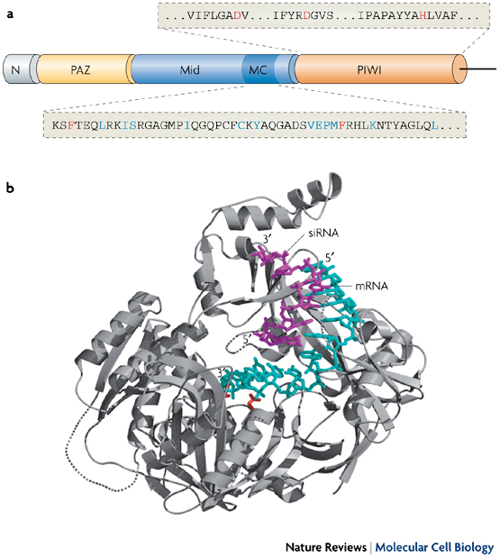
ARGONAUTE (AGO): At the core of RNA silencing
Notes:
The PAZ domain (yellow), which is important for small RNA association along with the PIWI domain, is situated near the N terminus of the protein (grey). The PIWI domain (orange) of cleavage-competent Argonaute proteins contains the catalytic residues DDH (highlighted in red), which are essential for cleavage. The cap-binding-like domain (MC; dark blue) is found within the Mid domain (blue), the region flanked by the PAZ and the PIWI domains.

Slide 21
The two main classes of small RNAs
Class | Precursor | Length | Origins | Mode of action
MicroRNA (miRNA) | Long, single stranded hairpin RNA | 20-22 nt | MIRNA genes | PTGS
Short interfering RNA (siRNA) | Long and short double stranded RNAs | 20-25 nt | Repeat-associated transcripts, convergent RNA transcripts, nature sense-antisense gene pairs, transgenes, viral RNAs, exogenously introduced dsRNAs | TGS or PTGS
PTGS: Post Transcriptional Gene silencing;
TGS: Transcriptional Gene silencing;
Notes:
Transposable elements (retroelements), convergent RNA transcripts, natural sense-antisense gene pairs, hairpin RNAs, transgenes, (anti-sense + sense transcripts)

Slide 22
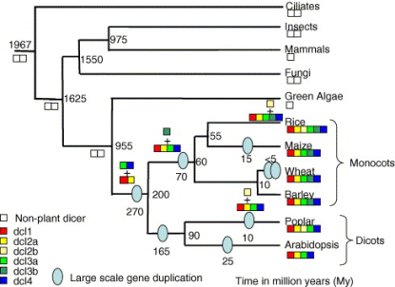
MiRNAs and siRNAs are processed by related but different DCL proteins
AtDCL1 produces miRNA
DCL1
AtDCL2,3 and4 produce siRNA
DCL4
Reprinted from Margis, R., Fusaro, A.F., Smith, N.A., Curtin, S.J., Watson, J.M., Finnegan, E.J., and Waterhouse, P.M. (2006) The evolution and diversification of Dicers in plants FEBS Lett. 580: 2442-2450 with permission from Elsevier.
Notes:
Note that mammals make do with one dicer, and insects and fungi with two. Like most components of the siRNA pathway, dicer-like genes are amplified in plants.
Plants have at least 4 DCL proteins, more than found in other organisms. The amplification of DCL family may allow plants great flexibility in pathogen defense responses.

Slide 23
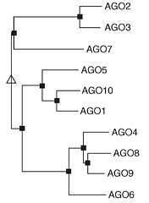
MiRNAs and siRNAs associate with several AGO proteins
AGO1 preferentially slices its targets and associates with miRNAs but also some siRNAs
AGO1
AGO4 preferentially associates with siRNA and mediates methylation of source DNA.
AGO4
Arabidopsis has 10 AGO proteins. They are not all well characterized and there is some functional overlap.
Reprinted from Vaucheret, H. (2008) Plant ARGONAUTES. Trends Plant Sci. 13: 350-358 with permission from Elsevier.

Slide 24
A significant portion of eukaryote genome is composed of transposable elements
Organism Size (MB) % of Repetitive
DNA
Arabidopsis 125 (14%)
Mung bean 450 (30%)
Human 3000 (45%)
Pea 4100 (70%)
Wheat 13500 (80%)
Originally thought to be transcriptionally inert
– transcribed then rapidly silenced
Notes:
Plant genomes include many transposon copies.
Although many transposons are inactivated by mutations in their DNA sequence, plants face the challenge of keeping the remaining copies transcriptionally silent. Transcriptional silencing is generally achieved by epigenetic
modification, particularly DNA methylation.
Transposons copy themselves to different loci inside the genome. These elements constitute a large fraction of eukaryotic genome sizes (C-values): about 45% of the human genome is composed of transposons and their defunct remnants.

Slide 25
Chromatin condensation and DNA methylation
Transcription
Histone proteins
NH2
NH2
Methyltransferase
CH3
N
N
O
N
O
N
DNA
Silencing
~
~
cytosine
5-methylcytosine
Heterochromatin - composed of mainly repetitive DNA
Inactive transcription
Notes:
This figure represents chromatin (DNA wrapped around histones) in an open and closed conformation. Chromatin modifications include covalent modifications to DNA and the histone proteins.
Chromatin is the state in which DNA is packaged within the cell. The nucleosome is the fundamental unit of chromatin and it is composed of an octamer of the four core histones (H3, H4, H2A, H2B) around which 147 base pairs of DNA are wrapped. There are at least eight distinct types of modifications found on histones (Table 1). We have the most information regarding the small covalent modifications acetylation, methylation, and phosphorylation.
Small RNAs can initiate gene silencing through covalent modifications of the DNA or its associated histone proteins, interfering with transcription.
This form of silencing is frequently associated with stably silenced DNA including centromeres and transposons, but also occurs at genes.
lysine 9 on histone H3 (H3K9) methylation
DNA can be covalently modified by cytosine methylation, carried out by DNA methyltransferases (DMTs)
DNA methylation is an important regulator of gene transcription and a large body of evidence has demonstrated that genes with high levels of 5-methylcytosine in their promoter region are transcriptionally silent, and that DNA methylation gradually accumulates upon long-term gene silencing.
DNA methylation stably alters the expression of genes in cells
37% of the methylated loci were associated with siRNA clusters

Slide 26
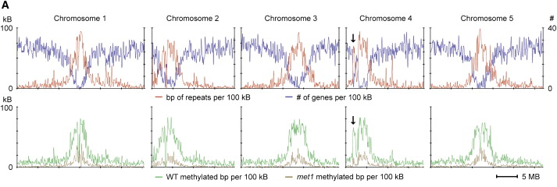
Extensive DNA methylation is found in the heterochromatic regions
Zhang et al., 2006. Cell, 126:6, 1189-1201.
Notes:
we found extensive DNA methylation in the heterochromatic regions of each of the five chromosomes, including centromeres, pericentromeres, and the heterochromatic knob on chromosome 4 (Figure 2A) (Hirochika et al., 2000, Lippman et al., 2004, Miura et al., 2001, Singer et al., 2001 and The Arabidopsis Genome Initiative, 2000). This distribution largely reflects the dense methylation of transposons and other repetitive sequences that are clustered in heterochromatin (Figures 2A and 2B).
The methylcytosine immunoprecipitation (mCIP) method was adapted from a previous study
DOMAINS REARRANGED METHYLTRANSFERASES 1 (DRM1) and 2 (DRM2), plant homologs of mammalian DNMT3, are responsible for CHH methylation through the RNA-directed DNA methylation (RdDM) pathway, which involves two plant specific RNA polymerases, RNA Pol IV and Pol V, as well as 24 nucleotide (24 nt) small interfering RNAs (siRNAs).
Sodium bisulfite -converts unmethylated cytosines to uracils (which after PCR are converted to thymines), while leaving methylated cytosines unconverted. By mapping bisulfite treated DNA back to the original reference genome, it is then possible to determine the methylation state of individual cytosines.

Slide 27
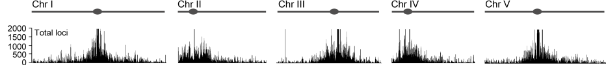
Heterochromatic siRNAs are preferentially derived from pericentromeric regions
Chromosome
Centromere
Abundance of small RNAs
Abundance of transposon/ retrotransposons
Kasschau, et al., 2007 PLoS Biol 5(3): e57.
Notes:
The density of small RNA-homologous loci is highest in the centromeric and pericentromeric regions which contain a high density of repeat sequence classes, such as transposons.
Distribution of small RNA-generating loci from all samples was analyzed across each chromosome. A scrolling-window analysis of all small RNA-homologous sequences (Figure 2A, total loci) was done. These sequences include all loci, regardless of how repetitive, that corresponded to a small RNA. For each chromosome, the density of small RNA-homologous loci was highest in the centromeric and pericentromeric regions (Figure 2). Pericentromeric and centromeric regions contain a high density of repeat sequence classes, such as transposons and retroelements. Indeed, the pericentromeric small RNA locus density roughly corresponded with the density of transposons and retroelements in each chromosome (Figure 2A). This could indicate that the repeat-rich centromeric/pericentromeric regions spawn relatively high numbers of small RNAs, or it could reflect the generation of relatively few small RNAs but from many highly repetitive loci
The majority of siRNA clusters (i.e., endogenous loci corresponding to high local concentrations of siRNAs) were heavily DNA methylated ( Figure 2D). However, ∼63% of methylated regions were not associated with siRNA clusters, suggesting that a large amount of DNA methylation is maintained without persistent targeting by siRNAs (Figure S7).

Slide 28
Heterochromatin siRNAs are responsible for RNA-directed DNA methylation (RdDM)
RdR2
RdR: RNA dependent RNA polymerase
RNA Pol IV
RNA Induced Transcriptional Silencing Complex (RITS)
DCL3
RNA Pol V
AGO4
DNA methylation (DMT)
Histone modification
siRNA
(24 nt)
Notes:
ClASSY:
Plants encode subunits for a fourth RNA polymerase (Pol IV) in addition to the well-known DNA-dependent RNA polymerases I, II, and III. By mutation of the two largest subunits (NRPD1a and NRPD2), we show that Pol IV silences certain transposons and repetitive DNA in a short interfering RNA pathway involving RNA-dependent RNA polymerase 2 and Dicer-like 3. The existence of this distinct silencing polymerase may explain the paradoxical involvement of an RNA silencing pathway in maintenance of transcriptional silencing.

Slide 29
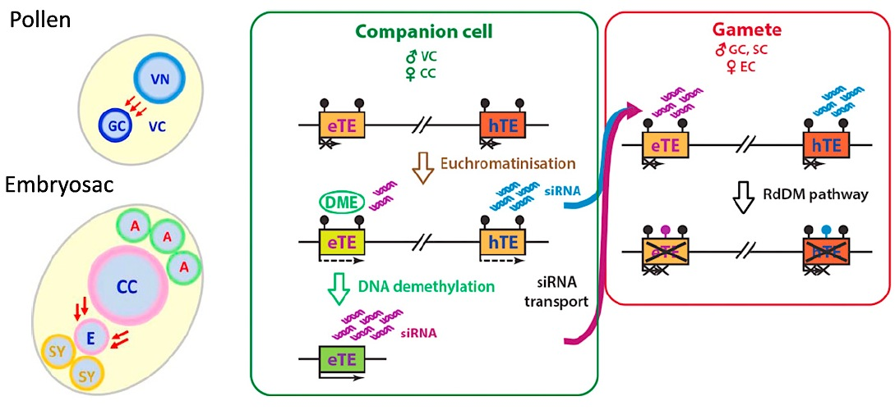
SiRNAs guide non-cell-autonomous epigenetic reprogramming
Companion cells induce epigenetic changes in the gametic cells during gametogenesis
VN: vegetative nucleus; VC: vegetative cell; GC: generative cell; CC: central cell; A: antipodal cell; E: egg cell; SY: synergid.
eTE: euchromatic transposable elements; hTE: heterochromatic TEs.
Reprinted from Feng, X., Zilberman, D., and Dickinson, H. (2013). A conversation across generations: soma-germ cell crosstalk in plants. Dev Cell. 24: 215-225 with permission from Elsevier.
Notes:
Epigenetic Interaction between the Male and Female Germlines and Their Companion Cells
epigenetics is the study of heritable changes in gene activity that are not caused by changes in the DNA sequence
siRNAs generated by companion cell “reprogramming” reinforce germline TE silencing via RNA-dependent DNA methylation (RdDM).
Left: putative transfer of silencing siRNAs (red arrows) between the vegetative cell (VC) and the germline in the pollen (GC, generative cell; SC, sperm cells) (top) and the central (CC) and egg cell (EC) (bottom); legend is the same as in Figure 3.
Middle and right: a common scenario shared by male and female gametophytes of Arabidopsis thaliana involving at least two mechanisms forming siRNAs in the companion cells: (1) chromatin decondensation and reconfiguration (“euchromatinization”) and (2) active DNA demethylation by DME. Two examples of small TEs localized at different regions of a chromosome are illustrated to distinguish the primary targets of these two mechanisms: a euchromatic TE (eTE, orange) and a heterochromatic TE (hTE, red). During gametogenesis, chromatin in the companion cells (CC in the embryo sac and the VC of the pollen) acquires a more open and accessible state via “euchromatinization,” allowing access of RdDM machinery such as PolIV and the subsequent synthesis of siRNAs from both eTEs and hTEs. Further, as eTEs are more “exposed” than hTEs, they can become targets for demethylation DME. siRNAs produced mostly from demethylated eTEs and euchromatinized hTEs then move into the germline (GC and SC of the pollen or the EC in the embryo sac) to methylate homologous TEs via the RdDM pathway. This RdD-induced hypermethylation reinforces innate TE silencing mechanisms already operating in the germline such as DNA methylation maintenance pathways and chromatin condensation.

Slide 30
PiRNAs maintain transposon silencing in the germline of animals
piRNAs - Interact with germline specific argonautes – piwi proteins
- Generated by a non-dsRNA mechanism
- Generated from specific locations in the genome 150 KB in size
- Maintains integrity of the germline

Slide 31
Plants can recover from viral infection and become resistant
Younger leaves produced on a virus-infected plant can be symptom-free, indicating that the plant has recovered from the infection.
OLDEST
YOUNGEST
Inoculate with virus
Notes:
The next six slides represent a key experiment in the elucidation of the roles of siRNAs in silencing viruses.

Slide 32
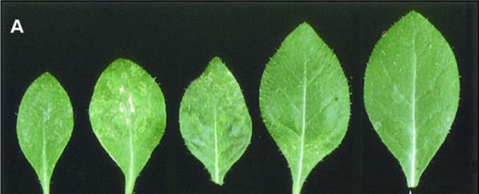
Plants can recover from viral infection and become resistant
OLDEST
YOUNGEST
Leaf inoculated with virus
Leaf inoculated with virus
Virus-induced cell death
No symptoms: recovery
No symptoms: resistance
From Ratcliff, F., Henderson, B.D., and Baulcombe, D.C. (1997) A similarity between viral
and gene silencing in plants. Science 276: 1558–1560. Reprinted with permission from AAAS.
Notes:
Note that the leaves produces after the initial virus infection do not show viral-induced cell death.

Slide 33
Viral induced gene silencing
Virus-encoded RdR
Viral ssRNA
Viral dsRNA
DCL2/4
AGO
21-22 nt
mRNA degradation
AGO
Notes:
Priming the Pump: siRNA Amplification
Most plant viruses are RNA viruses that replicate through a double-stranded RNA intermediate.
Double-stranded RNA is cleaved by DCL to produce siRNA which associates with AGO to silence virus replication and expression.

Slide 34
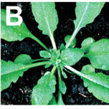
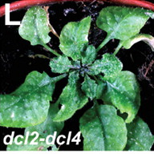
siRNA production mutants are more susceptible to viral disease
WT Arabidopsis inoculated with TRV
Double mutant of dcl2/dcl4 inoculated with TRV
TRV: Tobacco Rattle Virus
Deleris, A., et al. (2006) Science 313: 68-71.
Notes:
This is an example of a genetic study revealing the critical role of DCL (and siRNAs) in suppressing damage by a virus.
Tobacco Rattle Virus (TRV) silencing in wild-type Arabidopsis plants prevents disease symptoms. Mutants deficient in Dicer activity are unable to suppress viral infection

Slide 35
Virus infection causes systemic siRNA accumulation
AGO
DCL
Distal leaf
Inoculated leaf
Notes:
This figure shows that the siRNA is produced in infected tissues and in present in distal tissues. How does the siRNA get to the distal tissues? This question is addressed in the next few slides.

Slide 36
Systemic silencing is enhanced by signal amplification
DCL
RdR6
Primary siRNA
DCL4
AGO
Secondary siRNA: Can travel through plasmodesmata and vasculature.
Notes:
The use of mutants that interfere with siRNA production and amplification have demonstrated that these steps are necessary for systemic silencing. Amplification of the primary siRNA signal by RNA-dependent RNA polymerase is particularly important in the signal amplification and movement.
Silencing can spread beyond the site of the virus by production of secondary siRNA, which requires the action of RNA-dependent RNA polymerase (RdRP).

Slide 37
Viruses have suppressor proteins that interfere with RNA silencing
RdRP
DCL
DCL
Notes:
These highly specific viral proteins are necessary for viral pathogenicity, as shown on the next slide. They are also important tools for dissecting the silencing pathway.
By interfering with RNA silencing, the viral suppressor proteins can interfere with the plant’s viral defense mechanism. Suppressors can act at any step of the process.

Slide 38
Silencing of transgenes
Transgenes introduced into plants are frequently silenced by the siRNA pathway.
Silencing can be triggered by:
Very high levels of gene expression
dsRNA derived from transgenes
Aberrant RNAs encoded by transgenes
Transgenes are silenced post-transcriptionally and transcriptionally.
Notes:
Examples

Slide 39
Co-suppression is a consequence of siRNA production
Wild-type
Protein translated
mRNA
PRO
ORF
mRNA
Endogenous gene
Co-suppressed transgenic
Co-suppression
Sense RNA
AGO
PRO
ORF
AGO
AAAn
Sense construct
siRNA produced
PRO
ORF
mRNA
AGO
AAAn
Endogenous gene
De Paoli, E., Dorantes-Acosta, A., Zhai, J., Accerbi, M., Jeong, D.-H., Park, S., Meyers, B.C., Jorgensen, R.A., and Green, P.J. (2009). Distinct extremely abundant siRNAs associated with cosuppression in petunia. RNA 15: 1965–1970.
Notes:
The transgene triggers siRNA production which silences both genes.

Slide 40
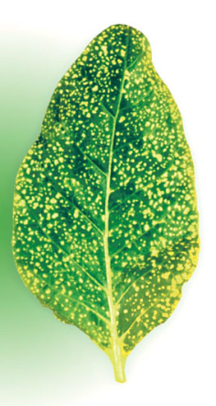
SiRNAs – Genomic Defenders
SiRNAs protect the genome by:
Silencing transposons and repetitive elements.
Suppressing invading viruses.
Silencing sources of aberrant transcripts.
siRNAs also maintain some genes in an epigenetically silent state.
Notes:
This image shows the hypersensitive response in a virus-infected tobacco leaf. siRNAs contribute to viral gene silencing.

Slide 41
RNAi technology – strategy for determining gene function
RNAi construct in the T-DNA region of a binary vector
35S
Sense
intron
Anti-sense
terminator
Transform Arabidopsis
Hairpin RNA
Isolate multiple transgenic plants – examine for phenotype
What is the gene’s function?

Slide 42
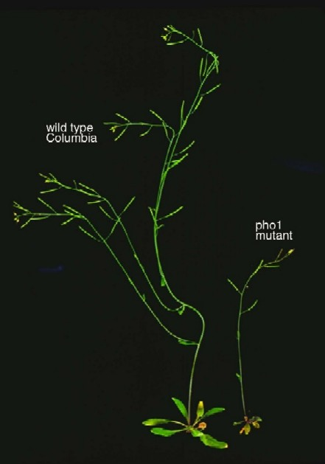
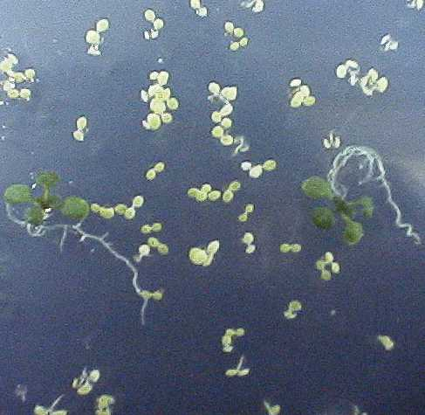
Making a Transgenic Plant
1. Transform A. tumefaciens with T-DNA (e.g. promoter- reporter gene)
2. Dip Arabidopsis flowers in Agrobacterium + T-DNA
Kan^{R}
LB
3. Plate Seed on Kanamycin
RB
T-DNA
Binary vector
Bacterial
selection
ori
E. coli
ori
(Agrobacterium)
5. Analyse gene
function via RNAi
4. Select Kan^{R} transformants

Slide 43
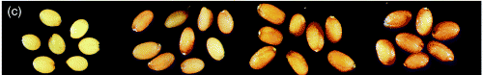
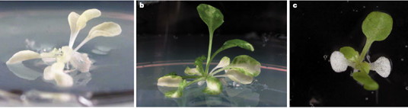
RNAi technology – variable but related phenotype
Different degrees of silencing – e.g. chalcone synthase
Different patterns of silencing – phytoene desaturase
Always need multiple transgenic lines (with similar phenotypes) to confirm a role for your gene of interest.

Slide 44
Pros vs Cons of RNAi technology
Range of expression levels – position of T-DNA in the genome
Choose conserved region - target gene families or redundant family members
Possible off-target effects
Can be unstable/ chimeric

Slide 45
SiRNA therapeutics
Great potential as a therapeutic tool: SiRNA-based therapeutics are under development for the treatment of diseases ranging from viral infections, to hereditary disorders and cancers.
Need safe and effective delivery methods: Polymers, lipids, peptides, antibodies and other small molecules.
Cytotoxicity and off-target effects need to be overcome.

